Slide 1
Master Thesis
Semantic Segmentation of Land Use with High-Resolution Orthophotos and Convolutional Neural Networks
Faculty of Mathematics and Computer Science
Karsten Köhler, Student ID No. 8690570

Slide 2
Content
Image Segmentation
Vegetation Analysis
Literature Review
Convolutional Neural Network
Reference Architectures
Dataset
Raster Preprocessing
Label Preparation
Experiments
Implementation
Metrics
Segmentation Results
Discussion
Literature Review
Spectral Vegetation Indices
Experiments
Implementation
Visualizations
Discussion

Slide 3
Research Question
Background: Emergency Landing Assistant, Emergency Landing Field Identification
Primary Objective: Semantic Segmentation of Land Use
Side Objective: Vegetation Density Analysis

Slide 4
Convolutional Neural Networks
Subset of Neural Networks
Highly efficient on grid-like data like e. g. images
Two common operations:
Convolution
Pooling

Slide 5
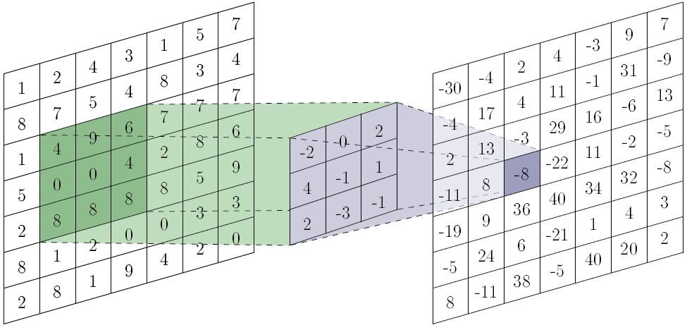

Convolution
Filter, move across image, learns shared parameters
hyperparameters: size, padding, stride
Produces convolved image (feature map)
https://towardsdatascience.com/a-comprehensive-guide-to-convolutional-neural-networks-the-eli5-way-3bd2b1164a53

Slide 6
Convolution
Multiple filters per convolution layer
Apply filters to previous feature maps
Filters can have depth
lots of computations required
Filters
Filters
Input
Feature Maps
Feature Maps

Slide 7
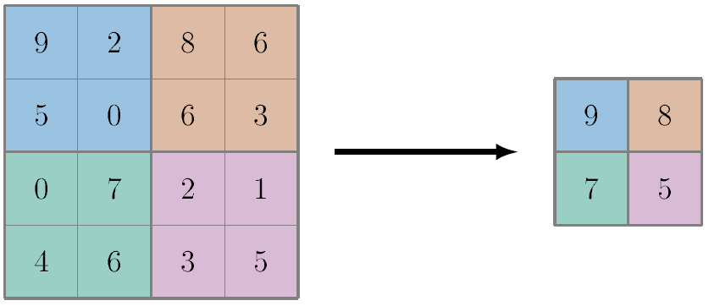
Pooling
Reduce spatial size
no trainable parameters
hyperparameters: size, padding, stride
Max Pooling

Slide 8

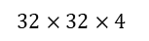
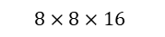
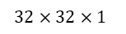
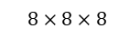
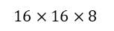
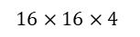
Example CNN Architecture
Alternating Convolution/Pooling Layers
Extract high-level features, computationally manageable
Only class predictions, no segmentation so far
FCN by omitting fully-connected layer, result is low-resolution heatmap
$$32×32×1$$
$$32×32×4$$
$$16×16×8$$
$$8×8×16$$
$$1×1×k$$
$$16×16×4$$
$$8×8×8$$
Conv.
Pool.
Conv.
Pool.
Conv.
Full
Class Predictions
Input Image

Slide 9
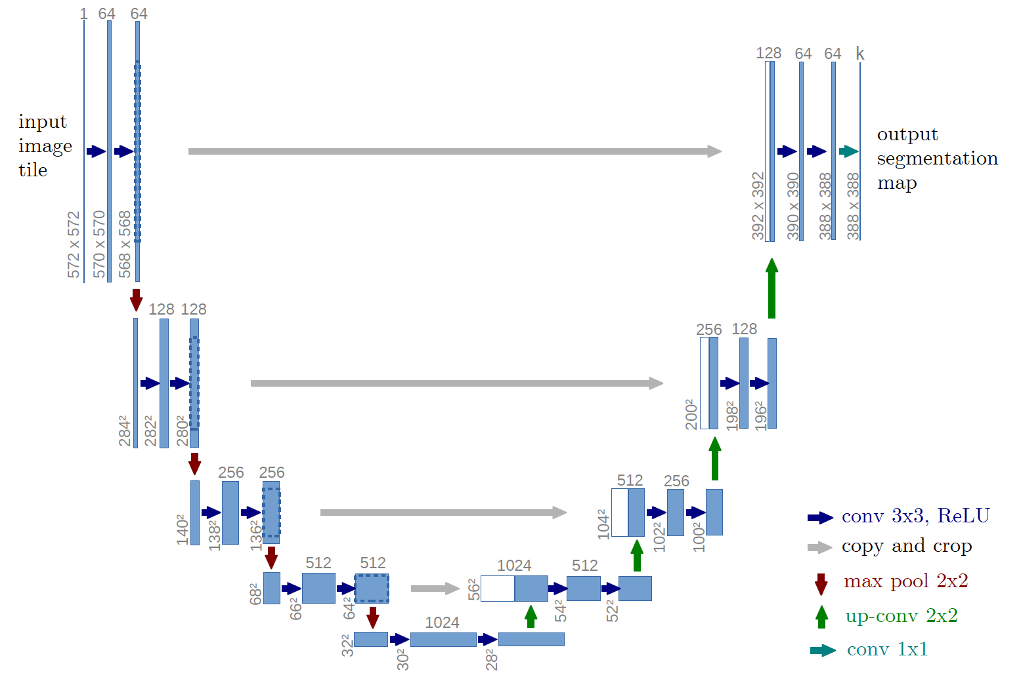
U-Net Architecture
contracting and expanding path
skip connections between paths
segmentation map is smaller than input image

Slide 10
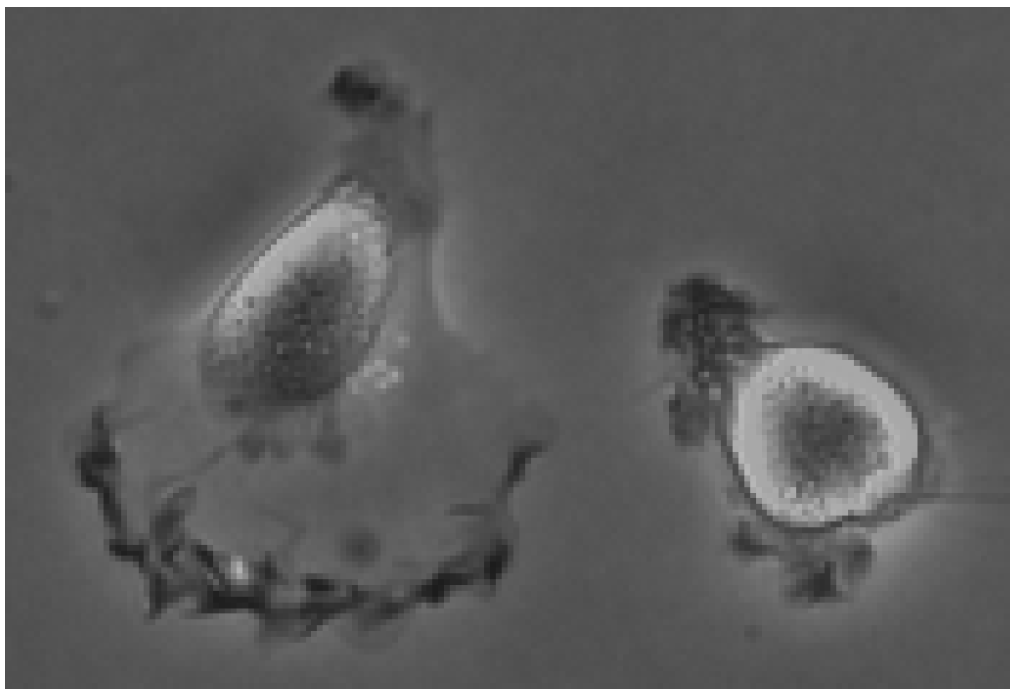
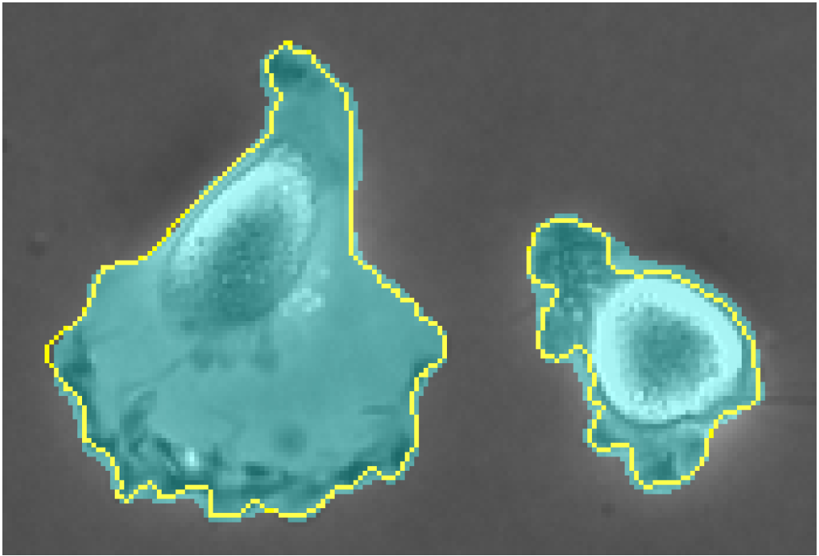
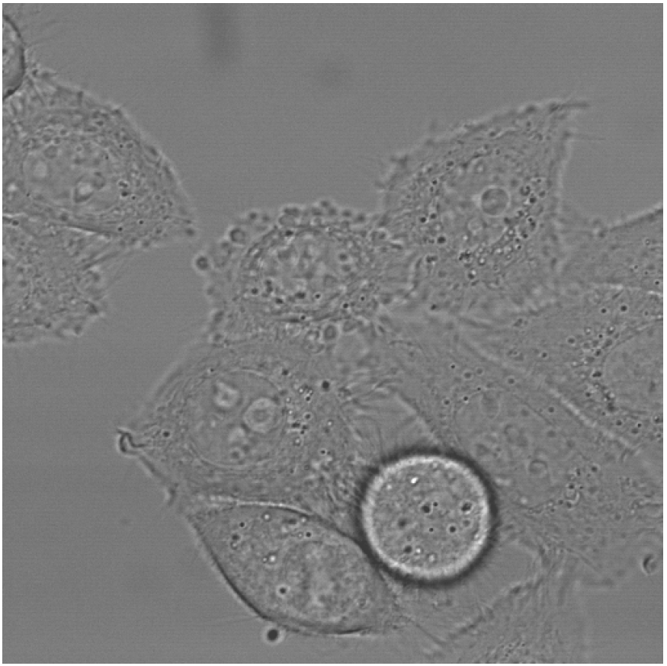
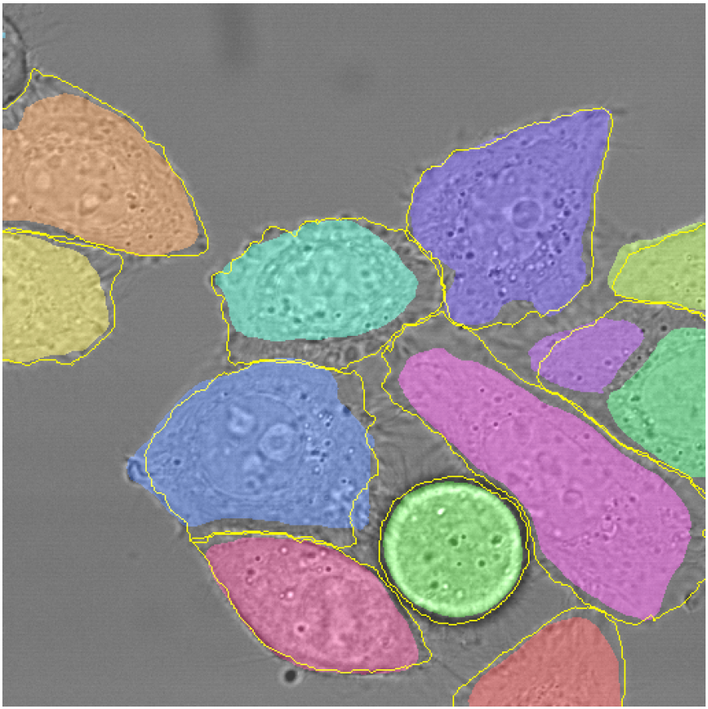
U-Net on ISBI Cell Tracking Challenge 2015
DIC-HeLa 77.56% average IoU
PhC-U373 92.03% average IoU

Slide 11
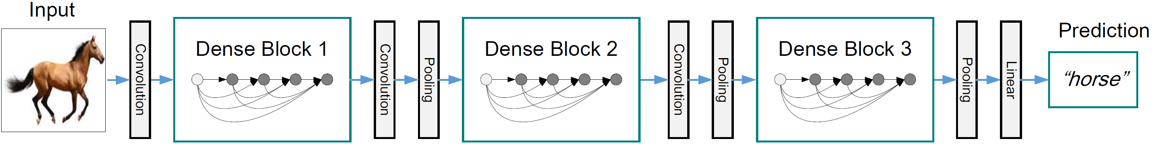
DenseNet Architecture
originally designed for image classification
introduced components called Dense Blocks
dense connectivity increases information flow and computational efficiency

Slide 12
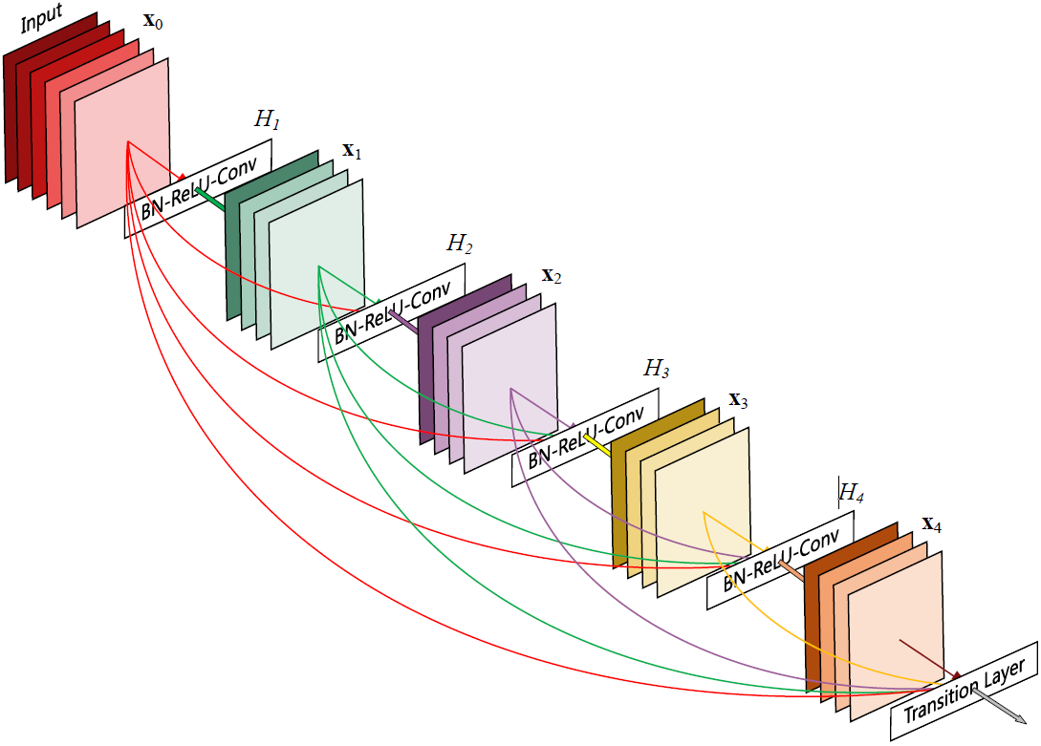
DenseNet Architecture – Dense Blocks
direct connections to all subsequent layers
growth rate determines new feature maps per step
transition layer at the end for downsampling
optional: compression in transition layer

Slide 13
FC-DenseNet Architecture
Input
Output
Layers | Feature Maps
Input | 3
3x3 Convolution | 48
Dense Block (4) + Transition Down | 112
Dense Block (5) + Transition Down | 192
Dense Block (7) + Transition Down | 304
Dense Block (10) + Transition Down | 464
Dense Block (12) + Transition Down | 656
Dense Block (15) | 896
Transition Up + Dense Block (12) | 1088
Transition Up + Dense Block (10) | 816
Transition Up + Dense Block (7) | 578
Transition Up + Dense Block (5) | 384
Transition Up + Dense Block (4) | 256
1x1 Convolution | c
Convolution
Convolution
Dense Block
Dense Block
C
Skip Connection
C
Transition Down
Transition Up
Dense Block
Dense Block
C
Skip Connection
C
Transition Down
Transition Up
Dense Block

Slide 14
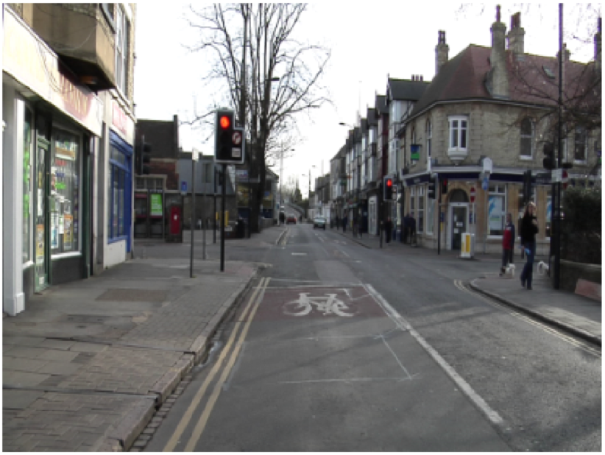
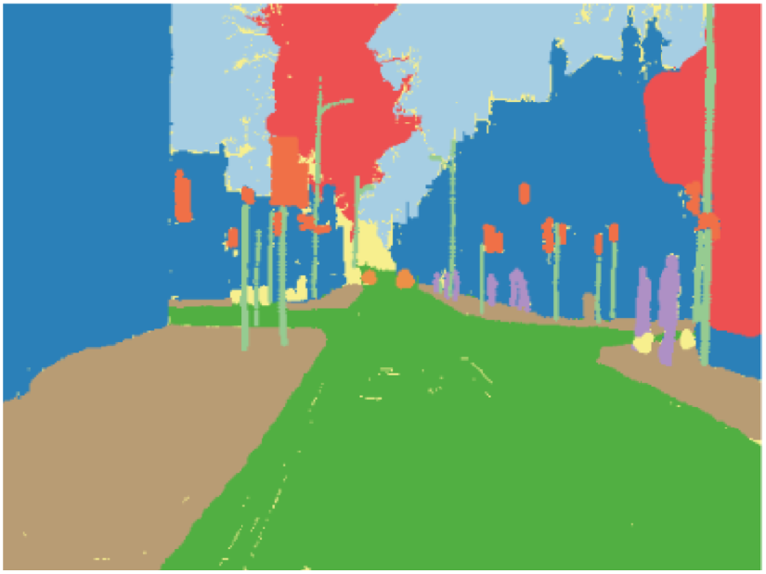
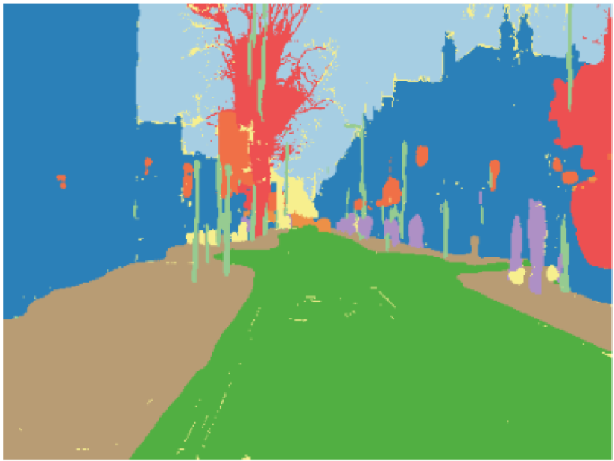
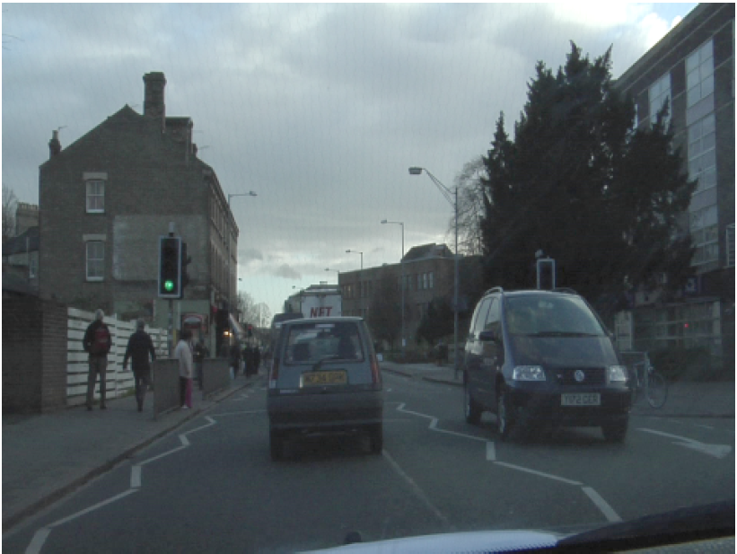
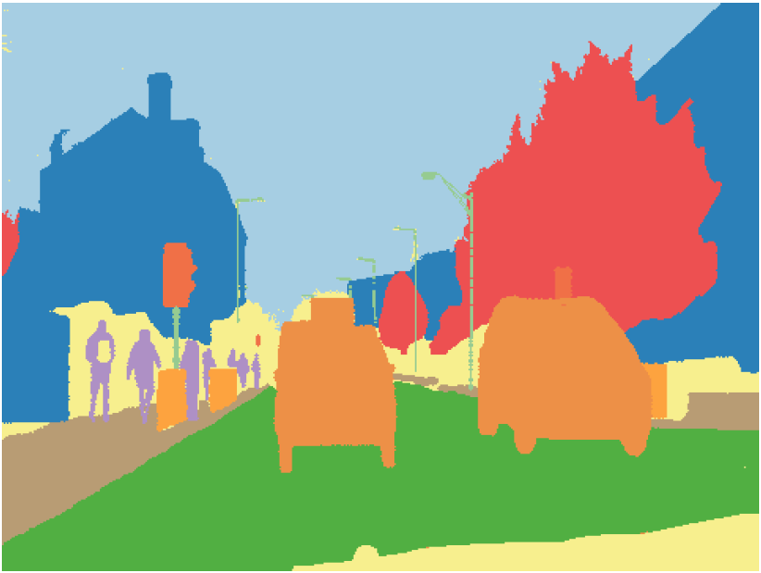
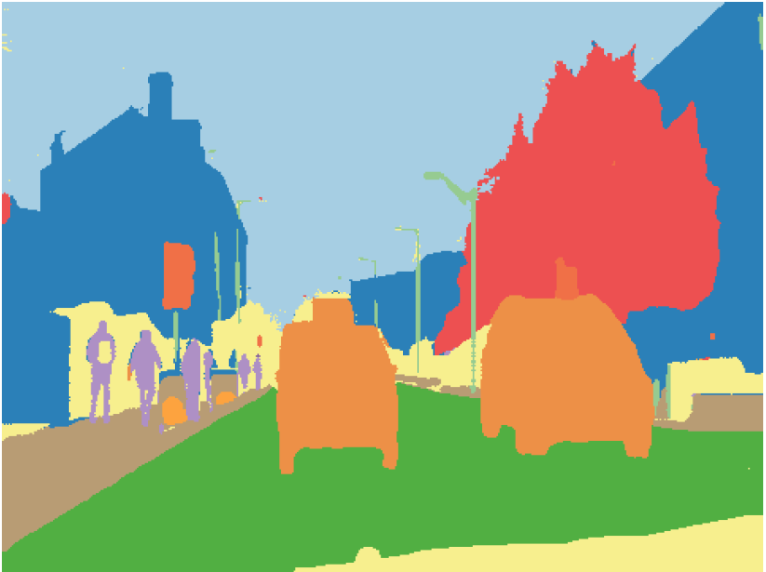
FC-DenseNet on CamVid Dataset
Model | Parameters (M) | Mean IoU (%) | Gl. Accuracy (%)
FC-DenseNet56 | 1.5 | 58.9 | 88.9
FC-DenseNet67 | 3.5 | 65.8 | 90.8
FC-DenseNet103 | 9.4 | 66.9 | 91.5
Original Image
Ground Truth
Prediction

Slide 15
W-Net Architecture
unsupervised learning approach
split into encoder and decoder parts
only encoder is used for inference
Postprocessing with Conditional Random Fields and Hierarchical Segmentation

Slide 16
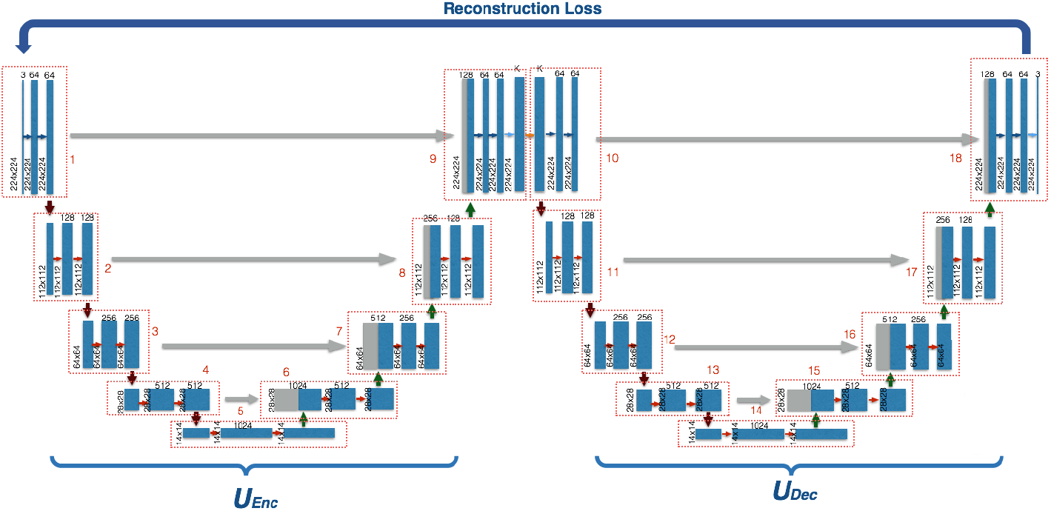
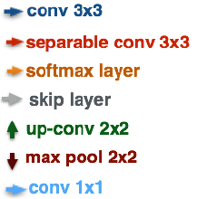
W-Net Architecture

Slide 17
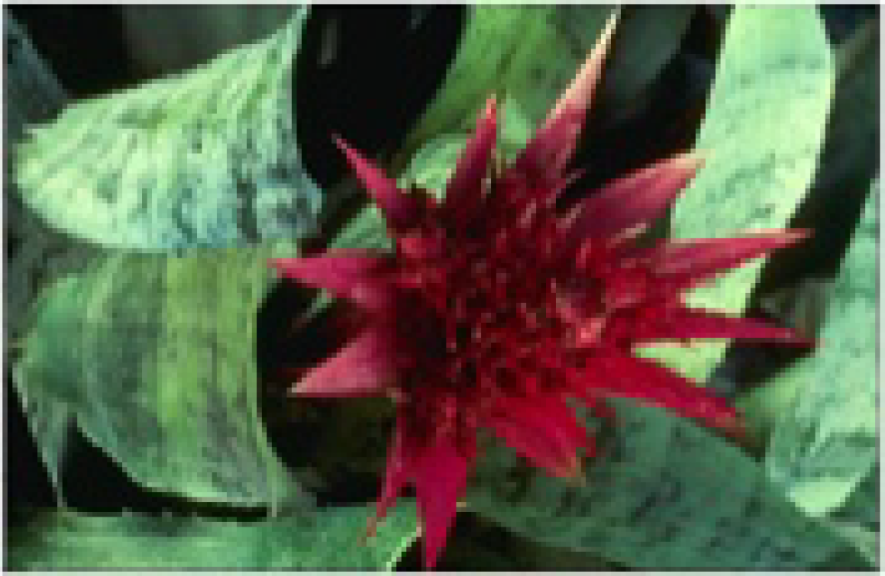
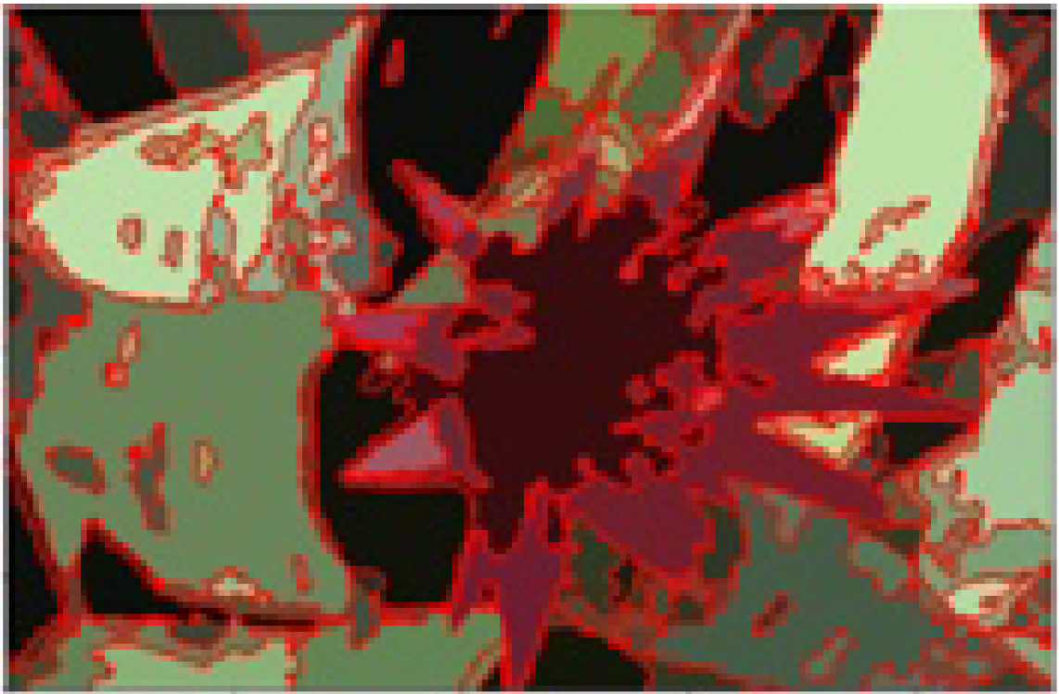
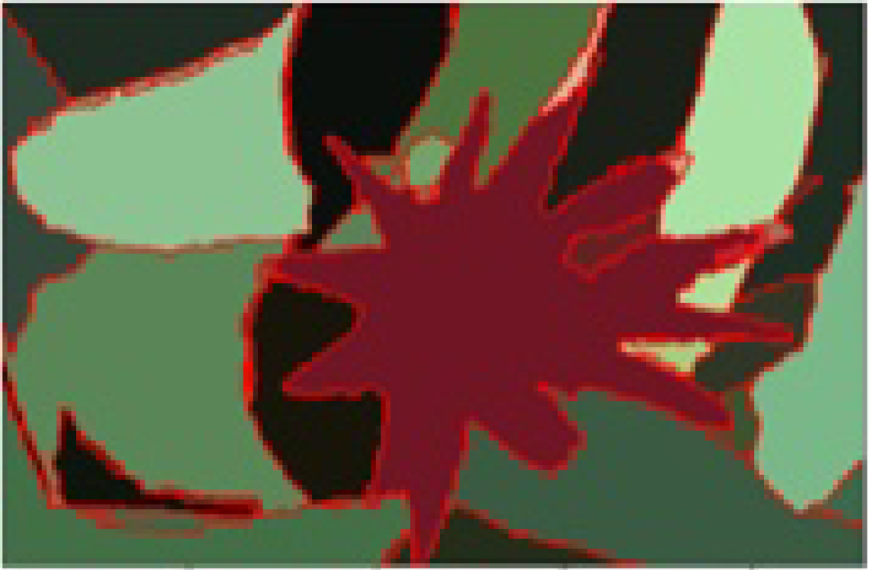
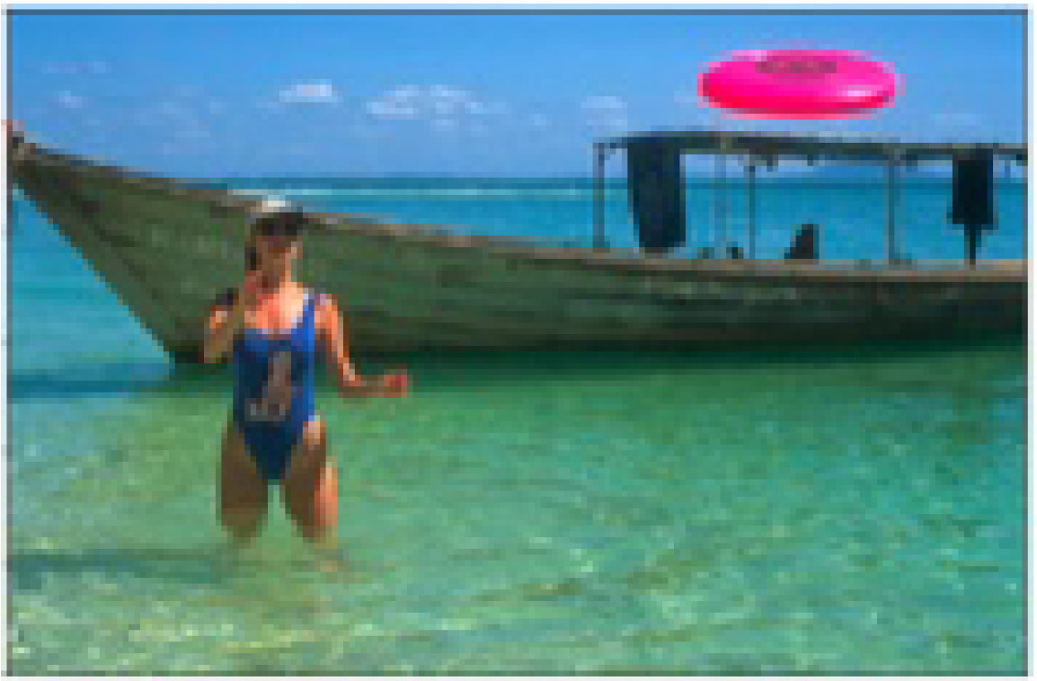
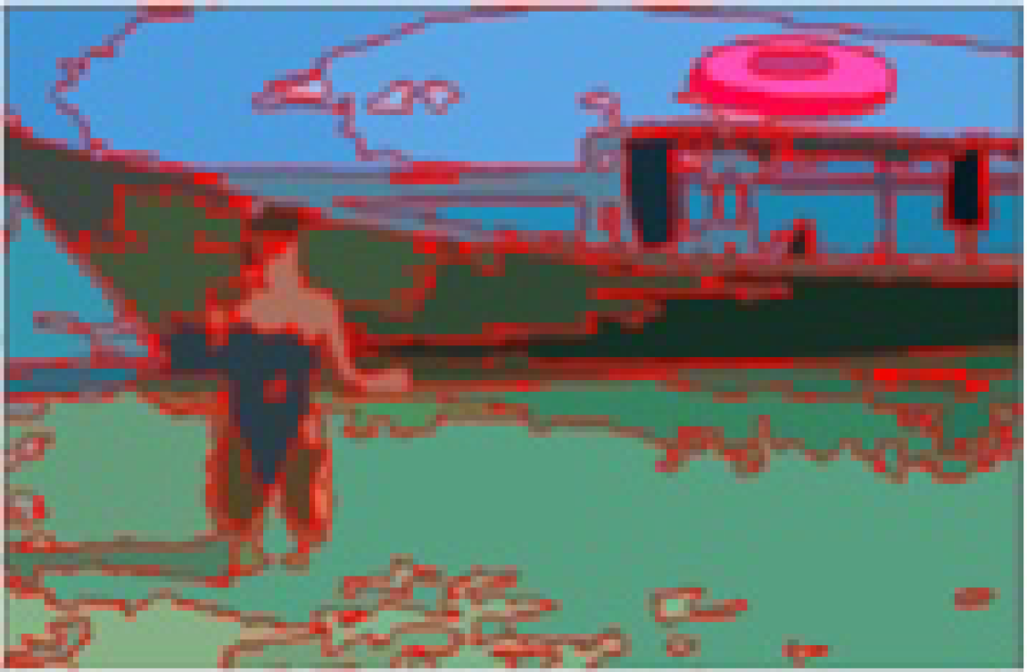
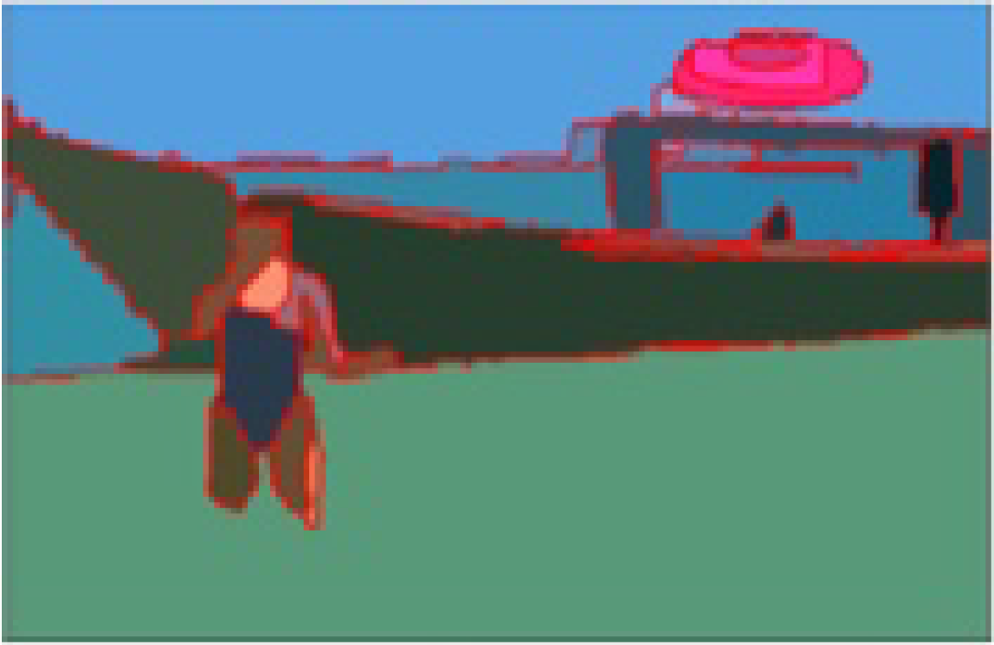
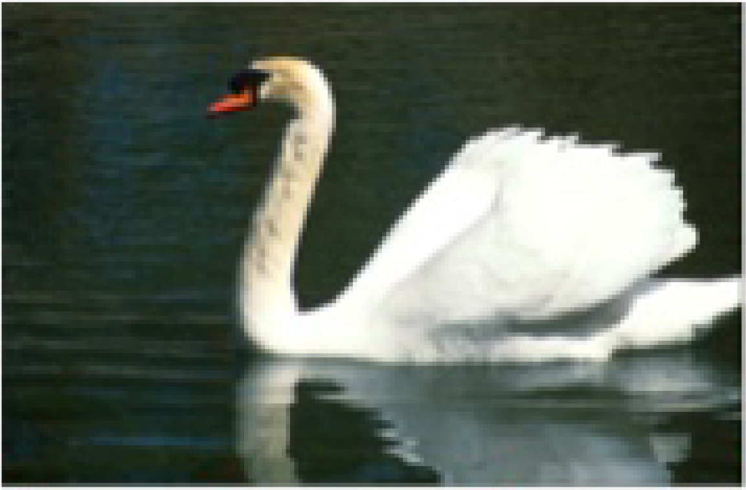
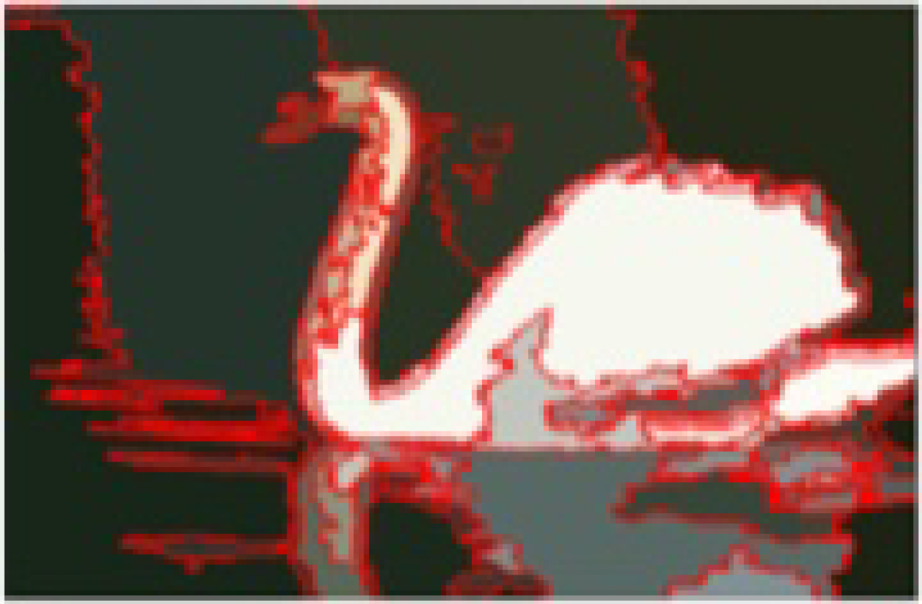
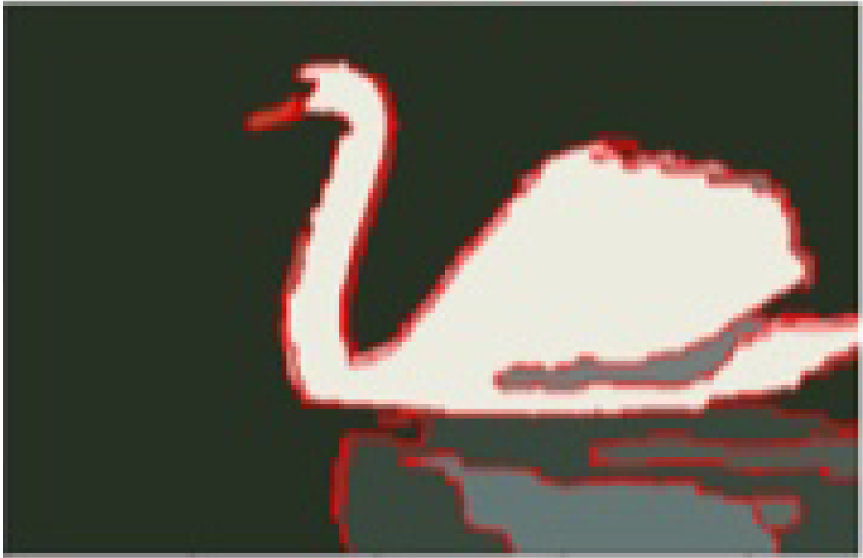
W-Net on BSDS500
Model | Segmentation Covering | Probabilistic Rand Index | Variation of Information
W-Net | 0.62 | 0.84 | 1.60
W-Net + PP | 0.64 | 0.85 | 1.47
Original Image
W-Net Prediction
After Postprocessing

Slide 18
Dataset Preparations

Slide 19
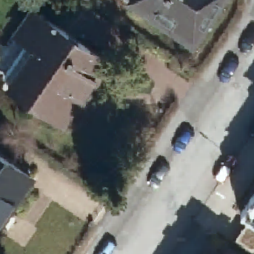
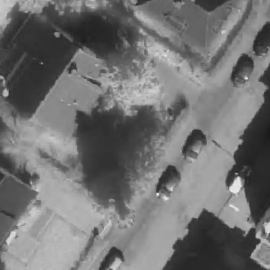
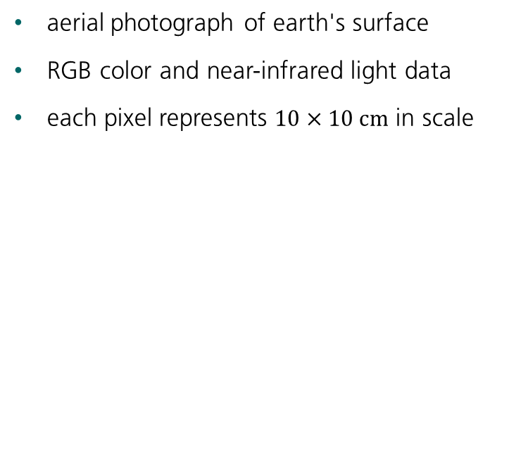
Digital Orthographic Photographs
aerial photograph of earth's surface
RGB color and near-infrared light data
each pixel represents $10×10 cm$ in scale
30 m
RGB Color
NIR values

Slide 20
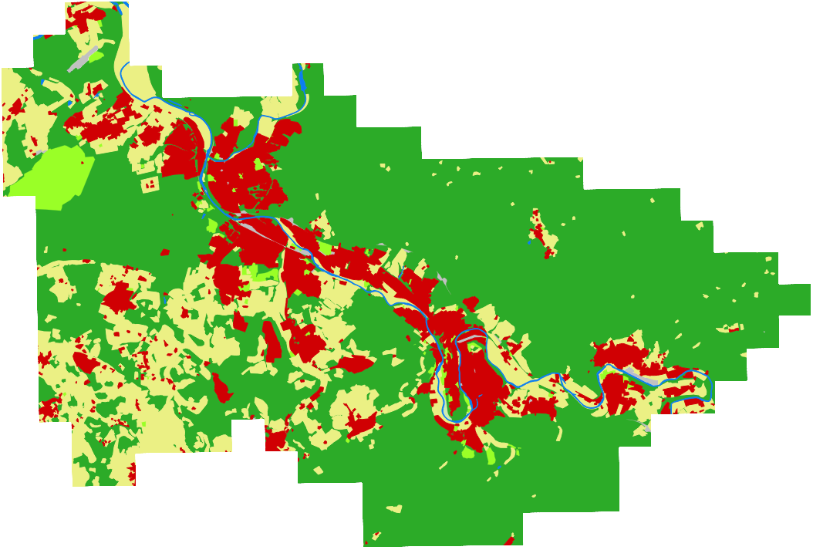
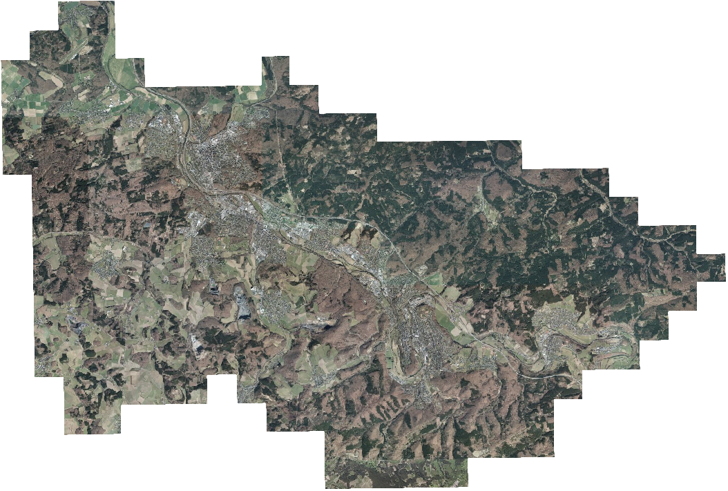
Raw Image Data
Total Area: 248.49 km²

Slide 21
Vector Graphics with Land Use
water
buildings
agriculture
forest
urban greens
traffic

Slide 22
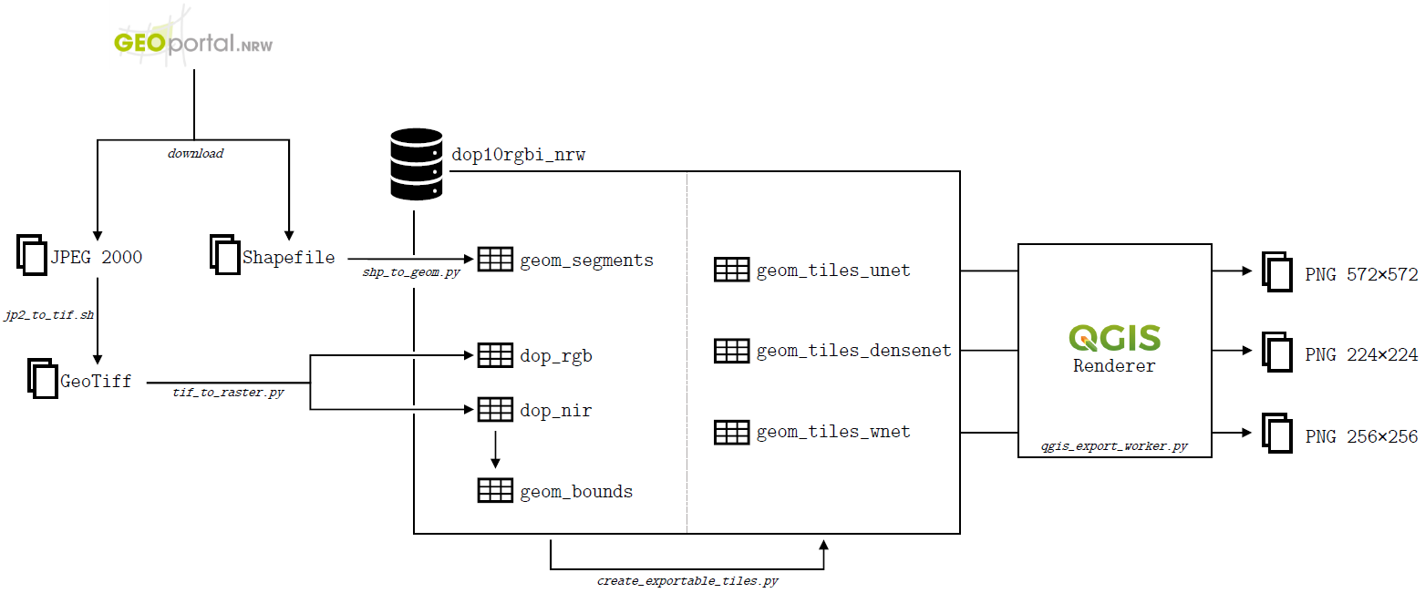
Data Preparations

Slide 23
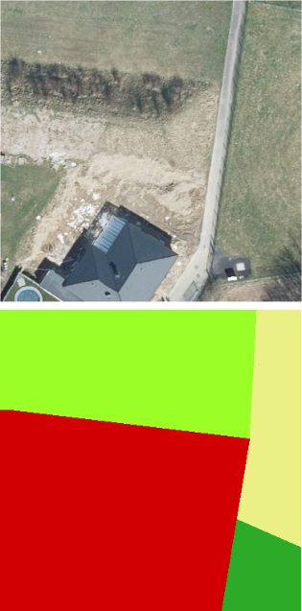
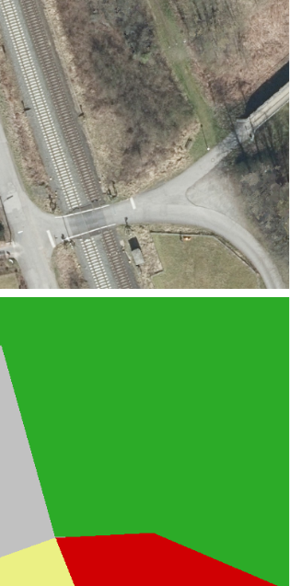
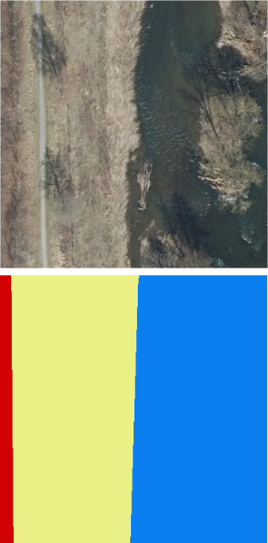
Inaccuracies in the Labels
buildings class includes land parcels
roads and railways submerged in surrounding class
riverbanks delineated poorly

Slide 24
Class Imbalance
forest, agriculture and buildings make up 97% of all data
Many training samples only consist of one class
could not be compensated with class weights

Slide 25
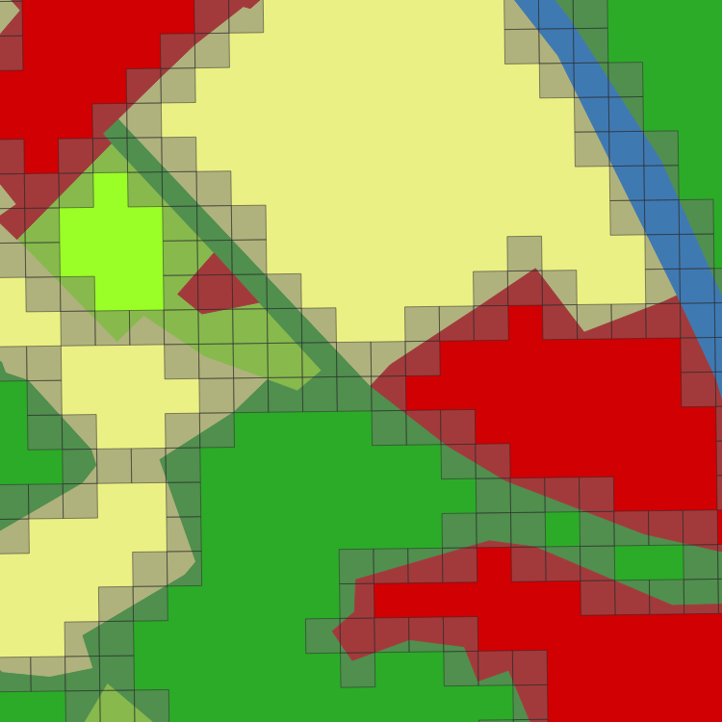
Class Imbalance – Addressing the Issues
only use samples containing two or more classes
focus on differentiation of classes
reduces class imbalance, because large patches are dropped
Notes:
forest 61,64%
buildings 13,53%
urban greens 2,53%
agriculture 20,86%
water 0,97%
traffic 0,48%

Slide 26
Final Datasets
Show statistics about three datasets, for each model separately

Slide 27
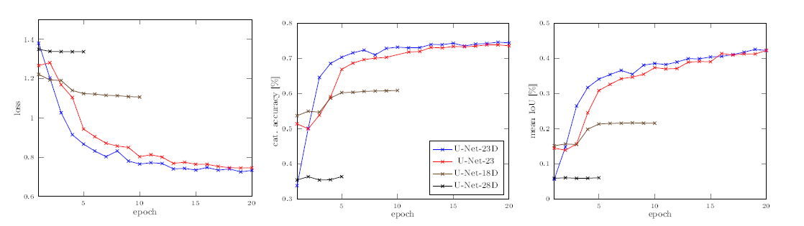
U-Net Experiments - Metrics
List configurations with variations and # of params

Slide 28
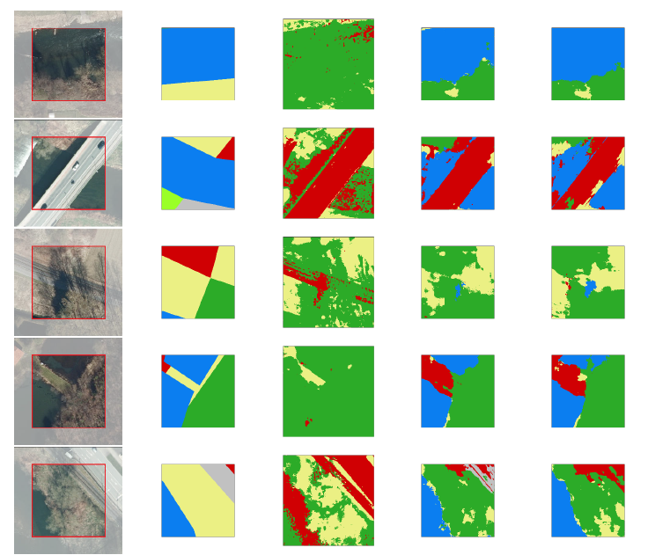
U-Net Experiments - Images

Slide 29
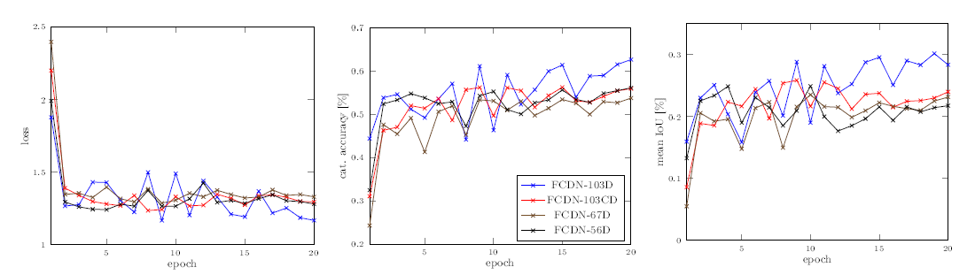
FC-DenseNet Experiments - Metrics
List configurations with variations and # of params

Slide 30
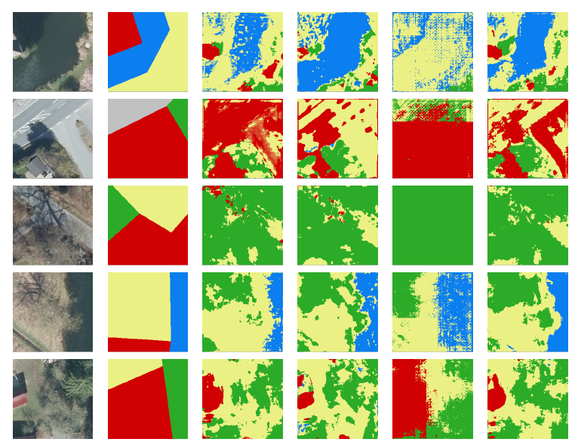
FC-DenseNet Experiments - Images

Slide 31
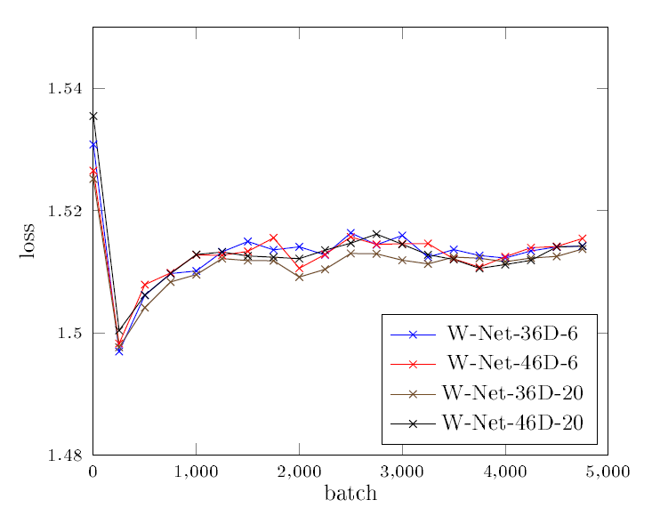
W-Net Experiments - Images
List configurations with variations and # of params

Slide 32
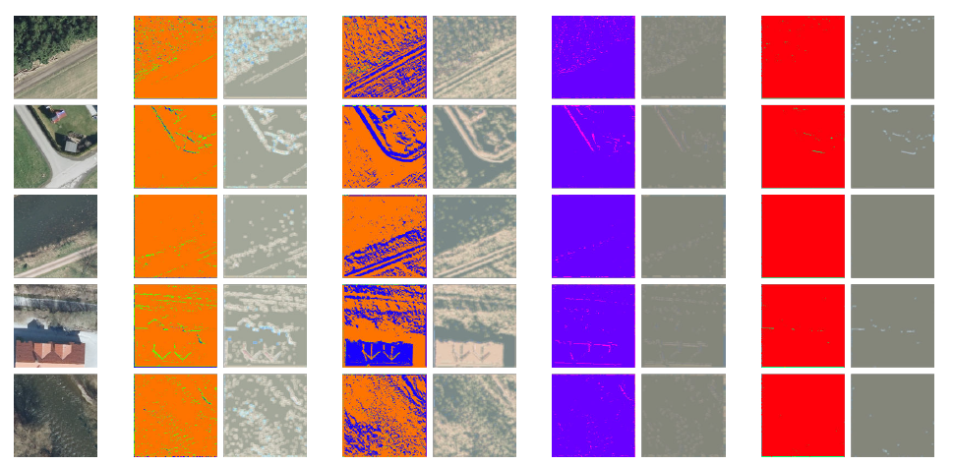
W-Net Experiments - Images

Slide 33
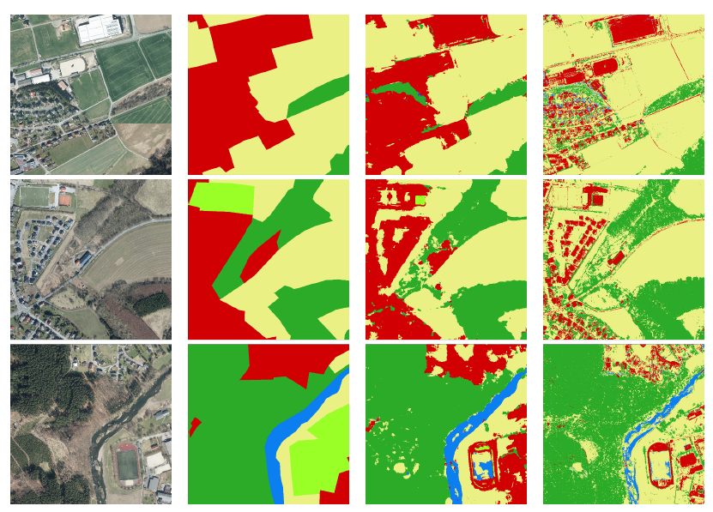
Larger Scale Images
Computation time?

Slide 34
Live Demo?
Show images, do live segmentation with U-Net and FC-DenseNet

Slide 35
Discussion

Slide 36
Vegetation Indices
Compares spectral bands of light

Slide 37
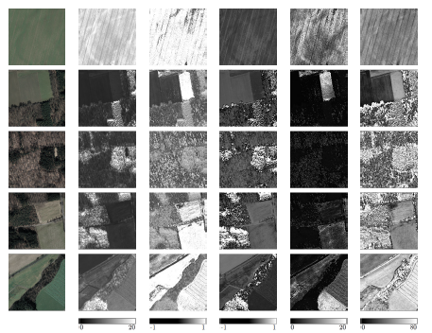
Ratio Vegetation Index

Slide 38
Normalized Difference Vegetation Index

Slide 39
Enhanced Vegetation Index

Slide 40
Soil-adjusted Vegetation Index

Slide 41
Modified soil-adjusted Vegetation Index?

Slide 42

Discussion
Show different results, which one is correct?
Only green vegetation, no dead vegetation, no other obstacles
No information about height and robustness

Slide 43
Conclusion
Supervised learning was good, U-Net and FC-DenseNet can both be used, Further improvements possible
Desicion if rough or fine segmentations
Not more data, but more accurate labels, maybe other regions of world
Vegetation indices are OK, but not as standalone factor
No recommendation of which one to use, depending on sensor etc

